Slide 1
STOCK RECOMMENDATION: COMPREHENSIVE ANALYSIS FOR INFORMED INVESTING
PRESENTED BY : DEVES PANCHARIYA
DATE: 09/11/2023

Slide 2

What is stock market?

Slide 3
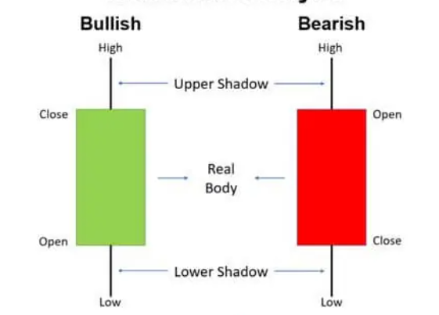
CANDLESTICK ANALYSIS

Slide 4
Introduction
Goal is to predict stock prices by analyzing historical data using ML algorithms
Focused on combining fundamental analysis (financial ratios) and technical analysis (price trends)
Fundamental data sourced from 10 years of Bombay Stock Exchange reports
Technical data compiled from Yahoo Finance (OHLC prices and volumes)
Key algorithms used were Random Forest, Artificial Neural Networks (ANN), and Long Short-Term Memory (LSTM) models.

Slide 5

Methodology
Followed standard data science pipeline: data collection, preprocessing, feature engineering, model training, evaluation
Trained models on fundamental and technical datasets separately
Combined predictions using stacking ensemble technique to consolidate signals

Slide 6
Datasets Used
There were three datasets used to follow this research idea:
Fundamental Analysis dataset
Technical Analysis dataset
Fusion Dataset

Slide 7
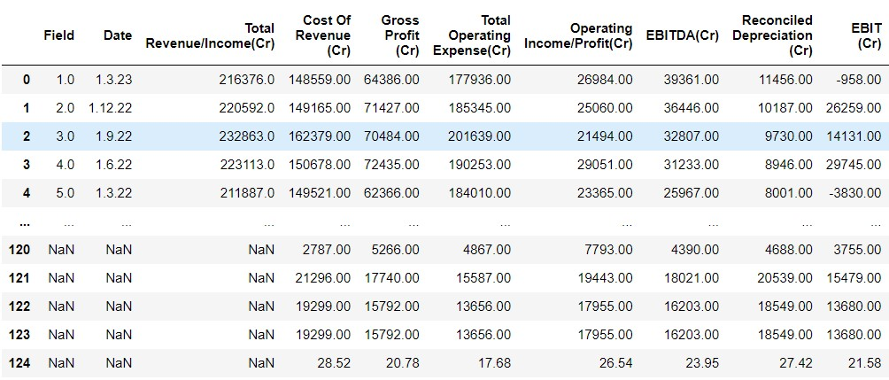
Fundamental Analysis
Dataset Source: Data collected from BSE (Bombay Stock Exchange)
Description: This dataset comprises fundamental financial data for the past 10 years. It includes critical indicators such as earnings per share (EPS), revenue, profit margins, and more.

Slide 8
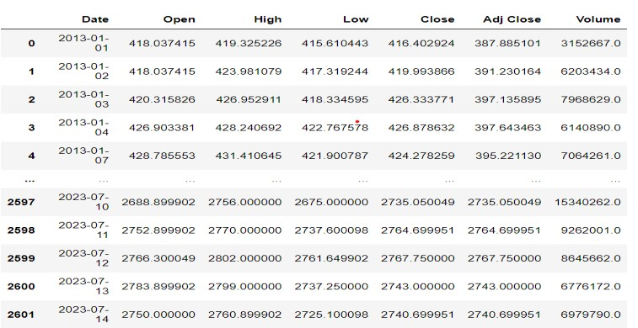
Technical Analysis
Dataset Source: Data retrieved from Yahoo Finance
Description: This dataset contains technical analysis data for the past 10 years, including stock price charts, moving averages, trading volumes, and various technical indicators.

Slide 9
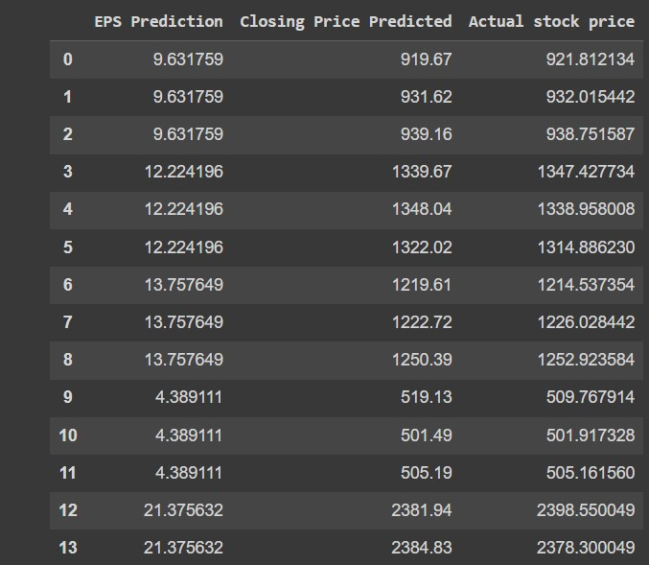
Fusion Dataset
Dataset Description: The Fusion dataset is the result of merging fundamental and technical analysis data.
Key variables in this dataset include:
Earnings Per Share (EPS) from Fundamental Analysis
Close Price from Technical Analysis
Actual Close Price

Slide 10
Algorithms
Random Forest : Random Forest is a potent machine learning method.
Widely used in various fields, including stock market forecasting.
Combines multiple independent decision trees for improved predictions.
Random Forest leverages ensemble learning.
It integrates individual decision trees into a more accurate model.
Each tree in the Random Forest is a decision tree.

Slide 11
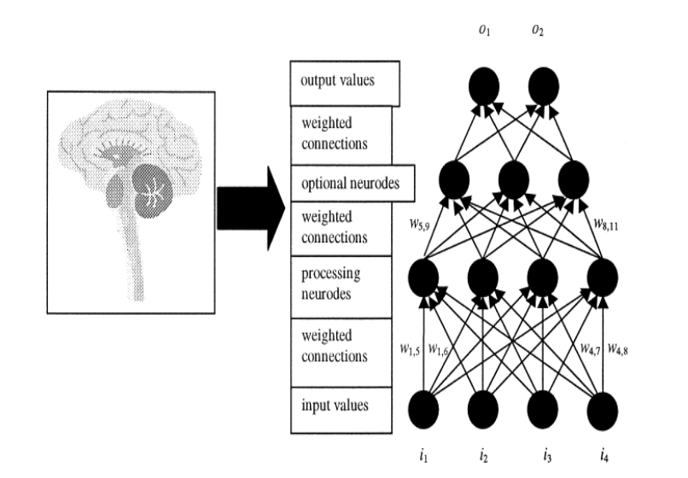
Algorithms Contd.
Artificial Neural Network (ANN)
Inspiration:
Modelled after the structure and function of the human brain
Key Components:
Input Layer: Receives input data
Hidden Layers: Process and transform data
Output Layer: Produces predictions or outputs
Benefits of ANNs:
Powerful tools for machine learning and artificial intelligence
Enable computers to learn and solve complex problems with remarkable accuracy

Slide 12
Algorithms Contd.
LSTM (Long-Short Term Memory)
Purpose:
Identify long-term dependencies and relationships in sequential data
Widely utilized in time series analysis, natural language processing, and stock market forecasting
Key Components of LSTMs:
Cells: Maintain a cell state that functions as a memory unit
Gates: Regulate the flow of information into, out of, and within the cell state
Input Gate: Controls the information that will be stored in the cell state
Forget Gate: Determines the information to be removed from the cell state
Output Gate: Controls the information output to the following layer and the prediction

Slide 13
Algorithms Contd.
Multilayer Perceptron Regressor:
Specialized neural network for regression tasks.
Composed of input, hidden, and output layers.
Utilizes nodes (neurons) for data processing.
Weights (w) determine the strength of connections between nodes.
Activation functions (e.g., sigmoid, tanh, ReLU) add nonlinearity for pattern recognition.
Benefits: Excels at regression tasks, versatile, and captures intricate data patterns.

Slide 14
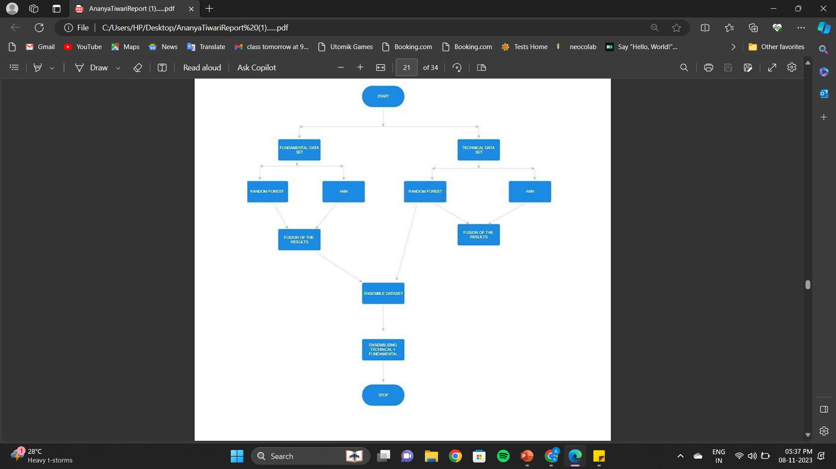
FLOWCHART

Slide 15
Results:
Stacking ensemble model achieved highest accuracy in predicting prices
Random Forest performed best on technical data.
ANN most suitable for fundamental data.
Correlation analysis showed positive relationship between actuals and predictions.

Slide 16
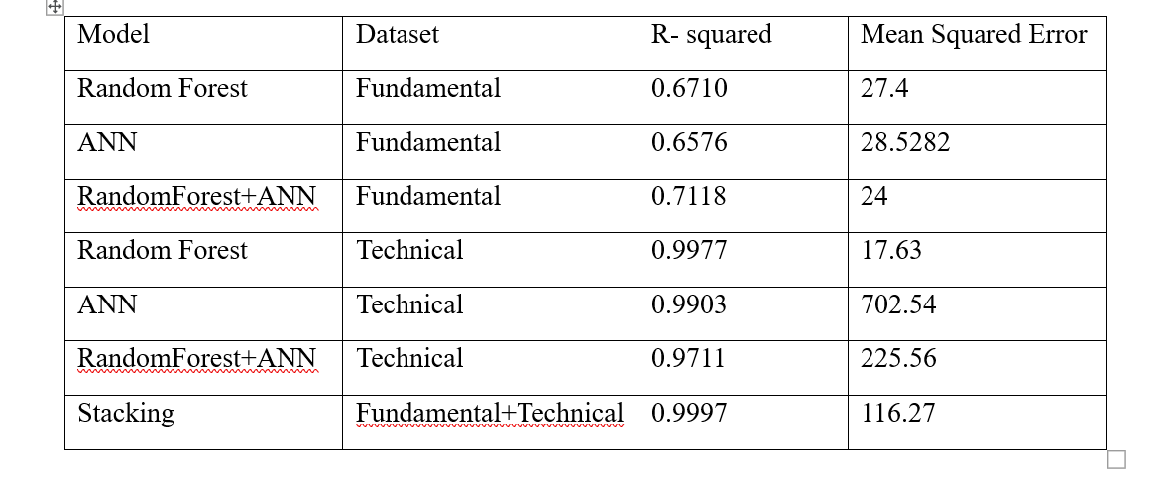
The following are the results :

Slide 17
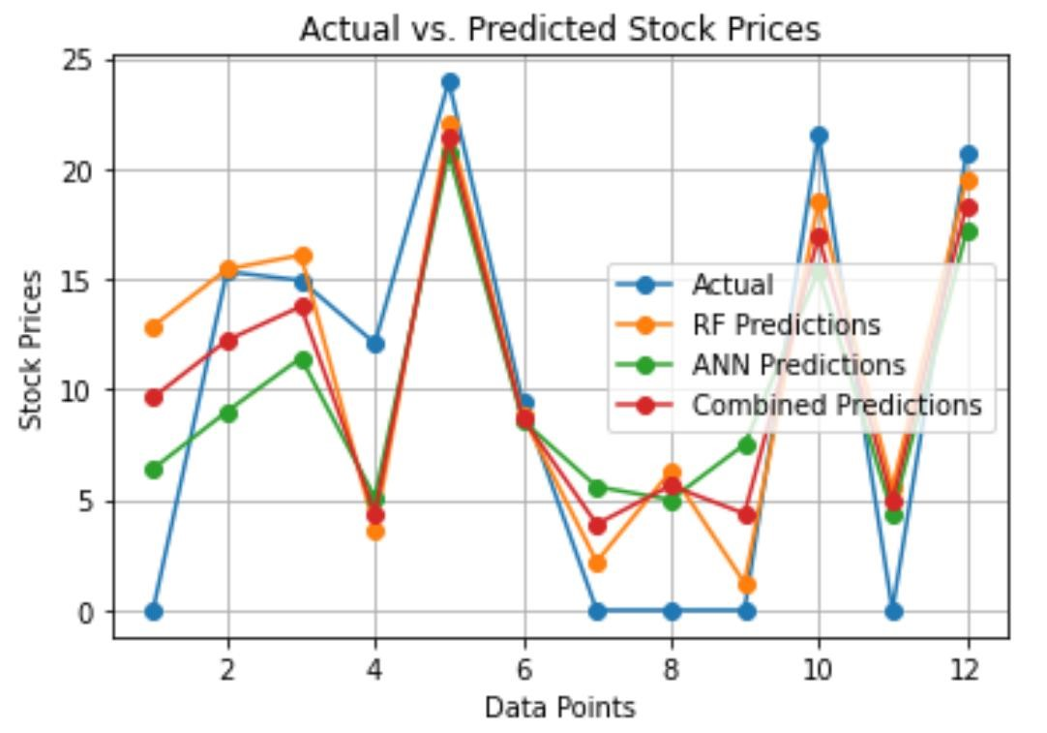
Fundamental Analysis Result:
Line chart shows feature importance scores for a combined model trained on fundamental analysis data. Y axis represents EPS and X axis represents data points.

Slide 18
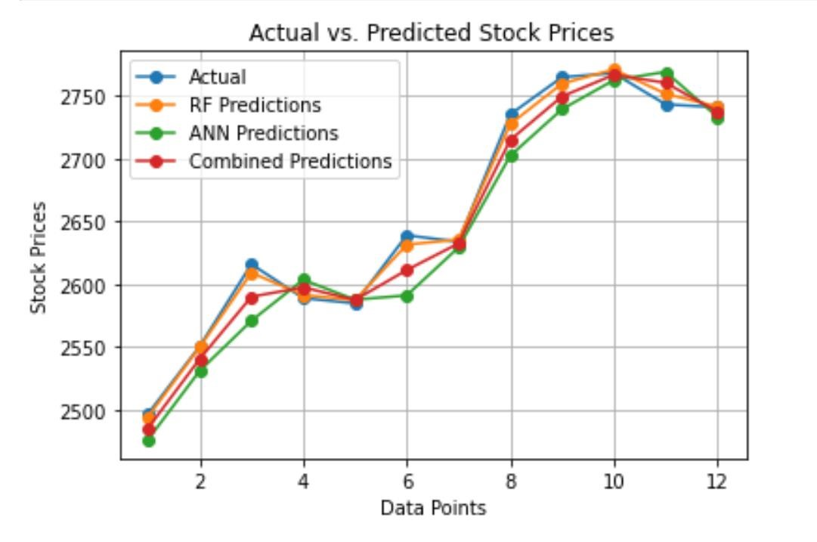
Technical Analysis Result:
Line chart shows feature importance scores for a combined model trained on technical analysis data. Y axis represents close price and X axis represents data points.

Slide 19
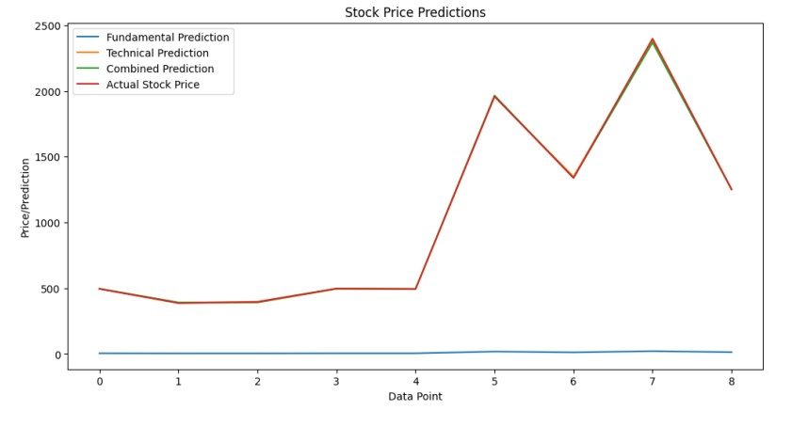
Ensemble Result:
Line chart shows feature importance scores for a combined model trained on ensemble data. Y axis represents price and X axis represents data points.

Slide 20
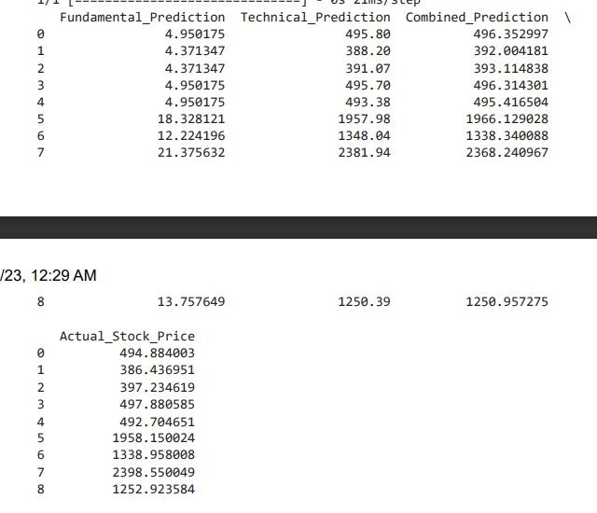
Final Output
Correlation matrix of stock market data shows strong correlations between Fundamental prediction, technical prediction, combined prediction of both and actual predictions.

Slide 21
Conclusion
Fusing fundamental and technical factors leads to more robust models
Demonstrated machine learning, especially ensembles, provide valuable financial insights
Models can be expanded by adding more data sources and further tuning

Slide 22
THANKYOU!

